Slide 1
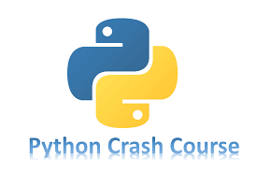

Slide 2
Chapter 6
DICTIONARIES
Brief Summary of Chapter 6
In Chapter 6, we will be covering how to work with dictionaries in Python, including creating, accessing, and manipulating data within them. We will explore different ways to loop through dictionaries, such as looping over key-value pairs, keys, or values. The chapter also introduces the concept of nesting, showing how to store lists inside dictionaries, dictionaries inside lists, and even dictionaries within dictionaries.

Slide 3
Working with Dictionaries
A dictionary in Python is a collection of key-value pairs. Each key is connected to a value, and you can use a key to access the value associated with that key. A key’s value can be a number, a string, a list, or even another dictionary. In fact, you can use any object that you can create in Python as a value in a dictionary. In Python, a dictionary is wrapped in braces, {}, with a series of key-value pairs inside the braces.
A key-value pair is a set of values associated with each other. When you
provide a key, Python returns the value associated with that key. Every key is
connected to its value by a colon, and individual key-value pairs are
separated by commas.
alien_0 = {'color': 'green', 'points': 5}

Slide 4
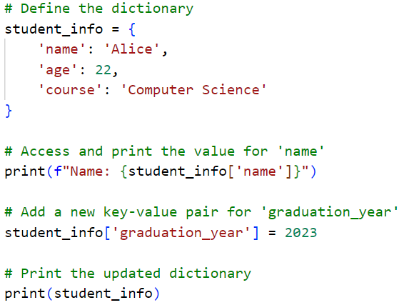
Create a Python file named student.py. In this file, define a dictionary student_info with keys 'name', 'age', and 'course'. Access and print the value for 'name'. Then, add a key 'graduation_year' with the value 2023 and print the updated dictionary.

Slide 5
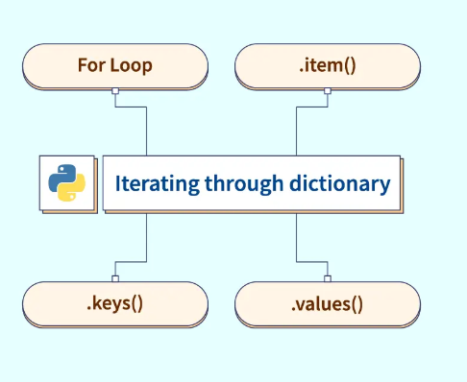
Looping Through a Dictionary
A single Python dictionary can contain just a few key-value pairs or millions
of pairs. Because a dictionary can contain large amounts of data, Python lets
you loop through a dictionary. Dictionaries can be used to store information
in a variety of ways; therefore, several different ways exist to loop through
them. You can loop through all of a dictionary’s key-value pairs, through its
keys, or through its values.

Slide 6
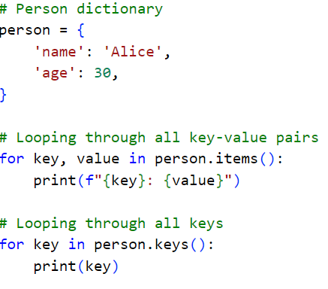
Looping Through All Key-Value Pairs and Looping Through All the Keys in a Dictionary:

Slide 7
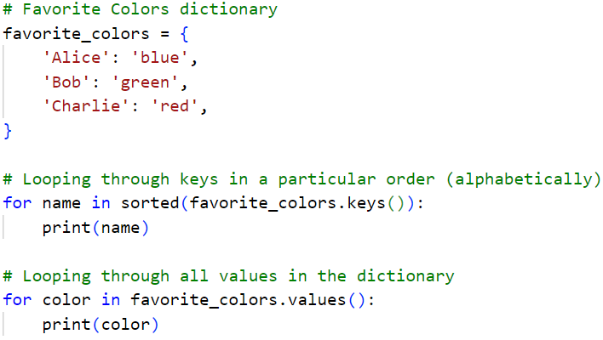
Looping Through a Dictionary’s Keys in a Particular Order and Looping Through All Values in a Dictionary:

Slide 8
Nesting
Sometimes you’ll want to store multiple dictionaries in a list, or a list of items as a value in a dictionary. This is called nesting. You can nest dictionaries inside a list, a list of items inside a dictionary, or even a dictionary inside another dictionary.
A List in a Dictionary:
You have a dictionary, and inside that dictionary, one of the values is a list. {} is used for the dictionary. [] is used for the list, which is a value in the dictionary.
A List of Dictionaries:
You have a list, and each item in that list is a dictionary. [] is used for the list. {} is used for each dictionary inside the list.
A Dictionary in a Dictionary:
You have a dictionary, and inside that dictionary, one of the values is another dictionary. {} is used both for the outer dictionary and for the inner dictionary.

Slide 9
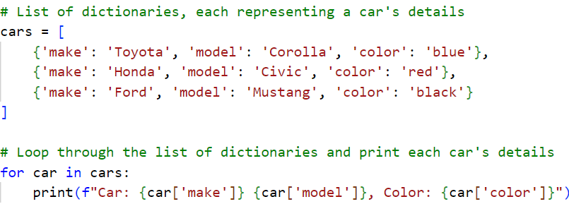
A List of Dictionaries:

Slide 10
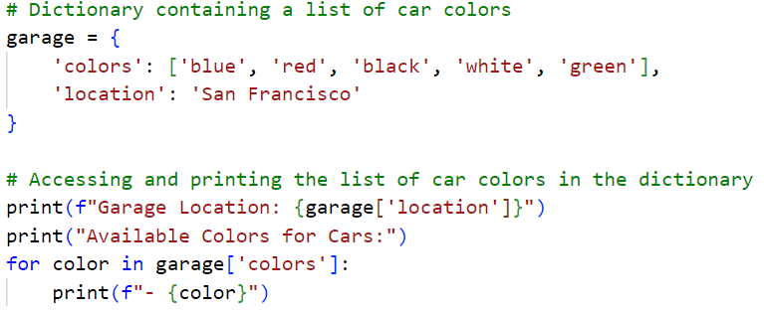
A List in a Dictionary:

Slide 11
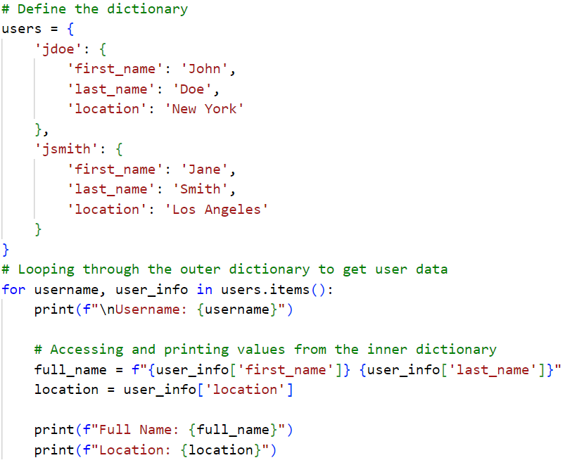
A Dictionary in a Dictionary:

Slide 12
Practice Exercise
Create a Python file named student_info.py, start by creating an empty dictionary and then add key-value pairs to it for a student's name, age, and major. Next, modify the student's age and major by updating the values in the dictionary. Finally, remove the key-value pair for the student's major. Make sure to print the dictionary after each modification to track the changes. Additionally, use the get() method to access a student's age safely without causing an error if the key is missing.
NB!! Layout examples use page 151 to 155

Slide 13
Practice Exercises
Do the following TRY IT YOURSELF on pages:
98
104
111

Slide 14
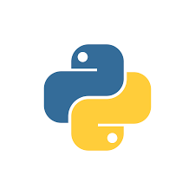
End
Of
Chapter 6

